Slide 1
Library Service Platform
- Project Update -
Prepared by:
Amy Beadle, LSP Statewide Program Manager

Slide 2
LSP Project Purpose and Plan
On behalf of the California Community College libraries, the California Community Colleges Chancellor’s Office (CCCCO), and the CCC Technology Center (CCCTC) have initiated a state-funded project to obtain a single cloud-based library services platform (LSP) to replace the various ILS systems now in use in any of the 114 libraries which choose to participate. The CCCCO and the CCCTC have partnered with the CCL to form project governance, develop a project workplan, select representative vanguard colleges and complete the procurement process.

Slide 3
LSP Project Purpose and Plan
After an in-depth evaluation process, the Ex Libris Alma and Primo products were selected to serve as the LSP platform for the California Community Colleges. The project team, CCL, vanguard schools and other stakeholders are now working with Ex Libris to assure a successful implementation across the system. A single implementation for all participating libraries will begin in January 2019 with all participants going live on the system in December 2019 or January 2020. The implementation fee and the 2020-21 subscription costs will be funded by the LSP project for all participating institutions.

Slide 4
LSP Project Ongoing Funding
A request for ongoing funding for an additional five years was submitted by the Council of Chief Librarians for consideration in the 2019-20 Legislative Budget. If awarded, funding would include the ongoing Alma/Primo subscriptions for all 114 colleges, the possible addition of the Ex Libris Leganto product (implementation and subscription) for all 114 colleges, as well as ongoing project management, administration and library systems expertise at the program level.

Slide 5
CCL Task Force
CCCCO
CCCTC
LSP Project Leadership
Doug Achterman, CCL President
Leslie Tirapelle, CCL President Elect
Alicia Virtue, CCL Treasurer
John Taylor, CCL Regional Rep
Gregg Atkins, CCL Executive Director
Gary Bird, CCCCO Project Monitor
Amy Carbonaro, LSP Statewide Program Manager
Amy Beadle, LSP Statewide Program Manager/Project Lead

Slide 6
Proposed LSP Governance & Workgroup Structure
LSP Advisory Committee
Implementation Work Group
Systems
Analytics
Discovery & User Experience
ELUNA Work Group
Resource Sharing
Circulation
Vanguard Work Group
Cataloging
Professional Development

Slide 7
LSP Implementation Schedule
September 2018 | Vanguard Phase Kick-off
October 31, 2018 | Agreements Signed from all Participating Institutions (Goal: 85%)
December 2018 | Vanguard Phase Concludes
Late January 2019 | Full Implementation Kick-off
June 2019 | Final 2019 Budget Released, ongoing Funding and Phase II Determined
December 2019-January 2020 | All Participating Colleges Go-Live

Slide 8
Vanguard Phase
11 previously selected colleges will participate in a pre-implementation phase of the project, lasting approximately four months (September 2018-December 2018). During this phase the participating colleges will go through the major steps of implementation, including training, data migration, network zone building, system configuration and initial workflow planning. The lessons learned from this phase will influence decisions to be made on collaborative workflows, new policies, new services, etc. that may be facilitated by the LSP

Slide 9
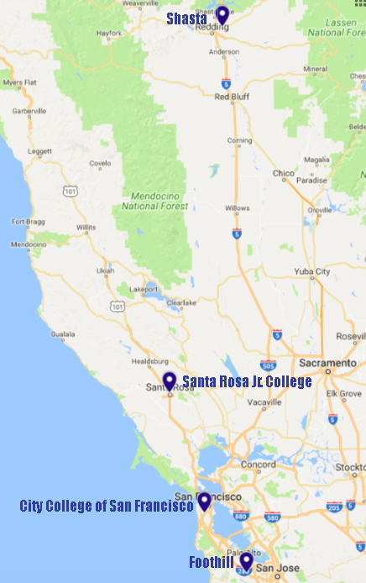
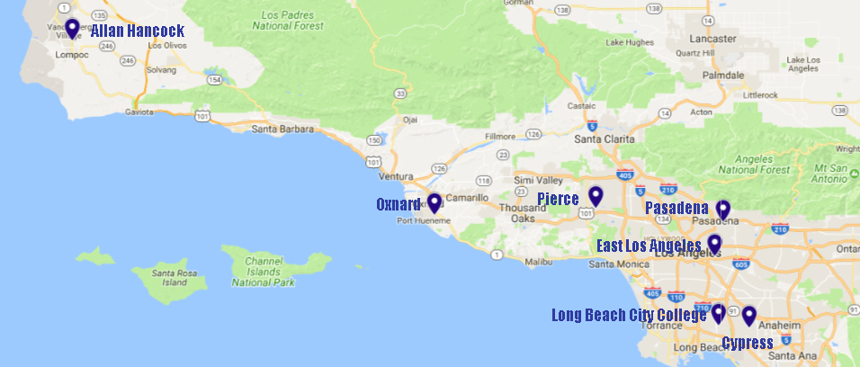
LSP Vanguard Colleges

Slide 10
LSP Interest and Participation
Based upon the project’s Environmental Scan (January 2018) and follow-up surveys, over 80 colleges have indicated their interest in being a part of the statewide LSP project. There are many benefits in doing so, including:
Cost Savings
Enhanced Discovery
Integrated Workflow
Improved Maintenance
Support Staff at the System-level
Unlimited Connectivity
Robust Analytics
State of the Art Architecture and Design
Collaboration with other CCC libraries
Better User Experience – for students and staff!

Slide 11
What Now?
If you know that you’re going to participate in the Statewide LSP, please sign and submit the Letter of Intent that was sent to all of the CCL Library contacts on 8/22.
Make certain that the Alma (9/12 at 1:00 pm) and Primo (9/13 at 1:00 pm) online demonstrations are on your calendar. Watch for sign-on information in the coming days.
Look for announcements regarding the regional meetings being set for mid-late September.
Talk to your Deans, Directors, VPIs and CBOs about the LSP project and make a plan for getting your Institution Participation Agreement signed and submitted by October 31, 2018.

Slide 12
Questions?
Contact:
Amy Beadle
Statewide Program Manager/Project Lead
abeadle@ccctechcenter.org
530.879.4170

