Slide 1
Pasadena City College library / pathways partnership
Integrating information literacy into first year experience
Shelagh Rose, Pathways Faculty Lead / serose@pasadena.edu
Kathryn McGuire, Librarian / kmcguire2@pasadena.edu
March 8, 2018
CCL Deans and Directors Meeting

Slide 2
Share how and why we developed and scaled up Pasadena City College’s Pathways program.
Explain how Pathways and the PCC Library work together to embed information literacy across the curriculum.
Goals

Slide 3
How is your college doing? Kahoot!!!

Slide 4
Our students

Slide 5
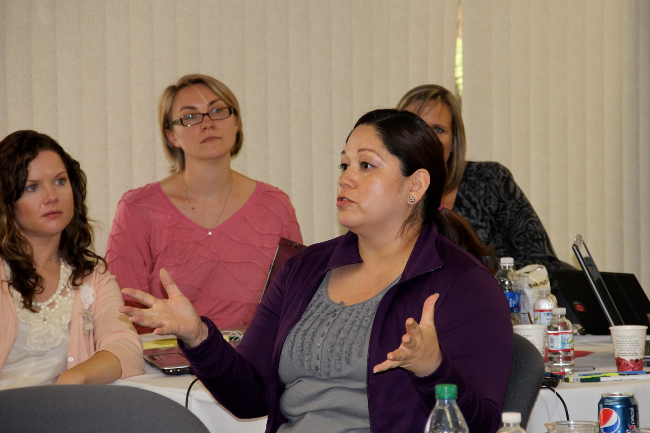
Leadership Retreat 2010

Slide 6
Developing a sense of urgency
5,537
Number of first-time students who enrolled at PCC in 2004

Slide 7
The 5,537 Six Years Later
Non-Dev Education
N = 2,129
10% earned an AA/AS
4% earned a certificate
41% transferred
55% had no discernible milestone
Developmental Education
N = 3,408
12% earned an AA/AS
5% earned a certificate
25% transferred
69% had no discernible milestone

Slide 8
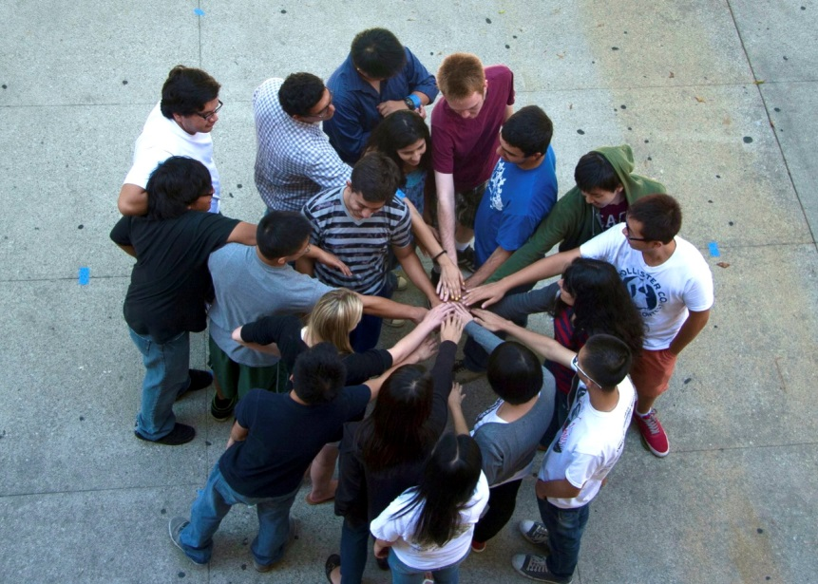
High-Impact Practices
Quality
Scale
Intensity
“Until colleges make high-impact practices inescapable for all students who need them, these practices will be only minimally effective in promoting the major gains sought in student success and completion.”
A Matter of Degrees, CCSSE, 2013

Slide 9
High-Impact Practices
First Year Seminars and Experiences
Common Intellectual Experiences
Learning Communities
Writing-Intensive Courses
Collaborative Assignments and Projects
Undergraduate Research
Diversity/Global Learning
Service Learning, Community-Based Learning
Internships
Capstone Courses and Projects
ePortfolio
Association of American Colleges and Universities, 2017

Slide 10
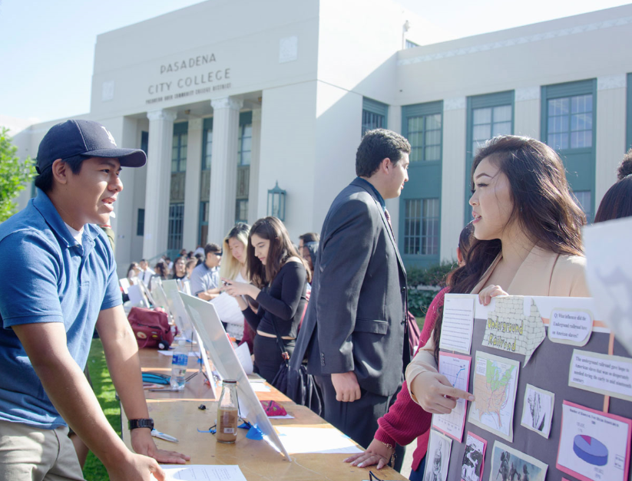
General education outcome #3
Information Competency: Use research and technical skills effectively and ethically to achieve an objective.
Competencies:
3.1 Information Literacy: Locate, retrieve, and evaluate information using appropriate research tools.
3.2 Research Proficiency: Conduct research and present findings effectively and ethically including the use of correct source citations.
3.3 Technological Literacy: Apply technology effectively to locate, evaluate, interpret, organize, and present information using appropriate research tools.

Slide 11
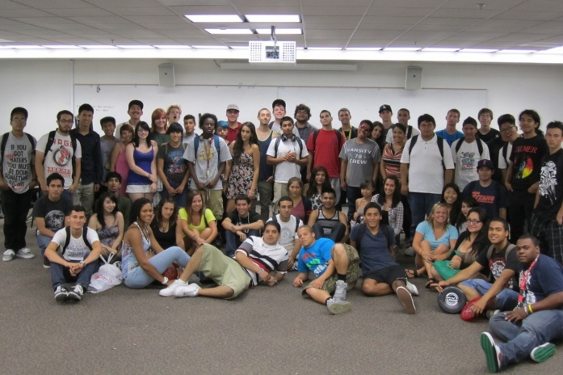
2011

Slide 12
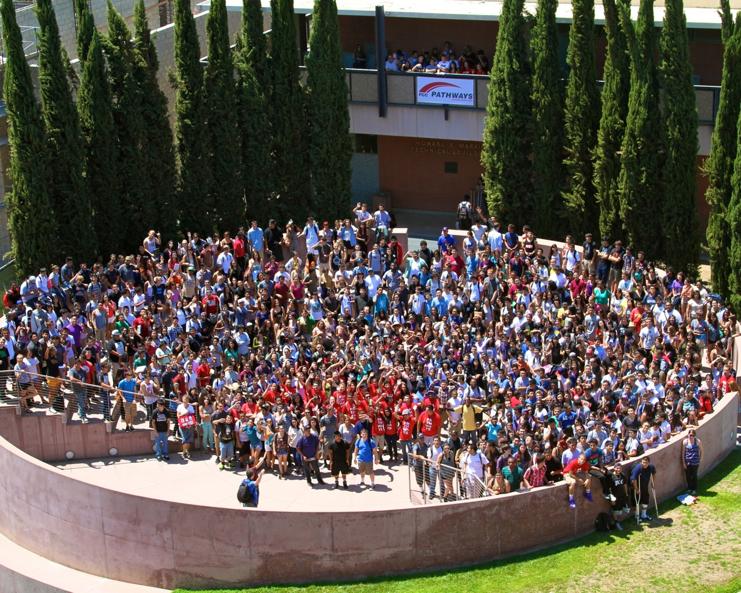
2012

Slide 13
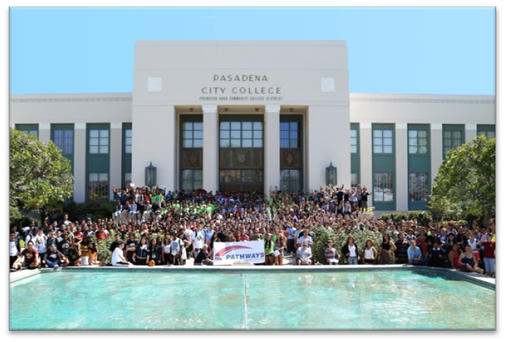
2013

Slide 14
2014

Slide 15
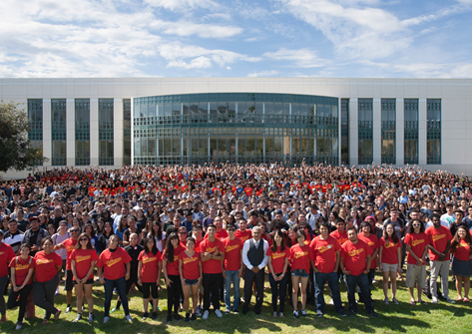
2015

Slide 16
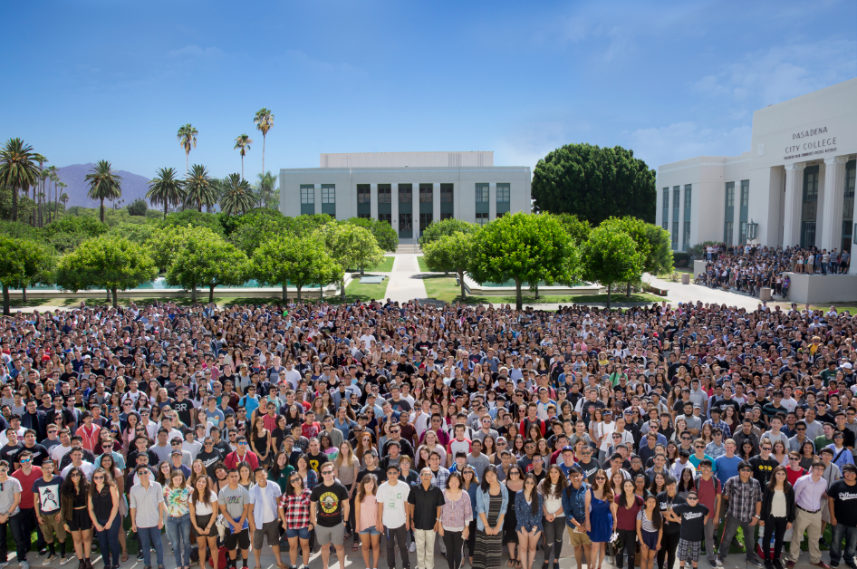
2016

Slide 17
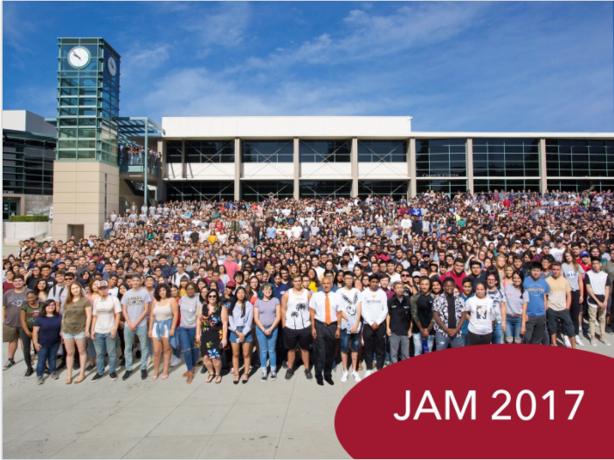

Slide 18
Pathways growth

Slide 19
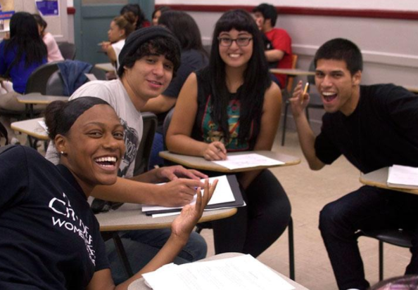
Pathways Requirements
Full-time schedule
English
Math
College 1
Support and Engagement
Orientation (Jam)
Career/Major exploration
Success Team (coaches, tutors, counselors)

Slide 20
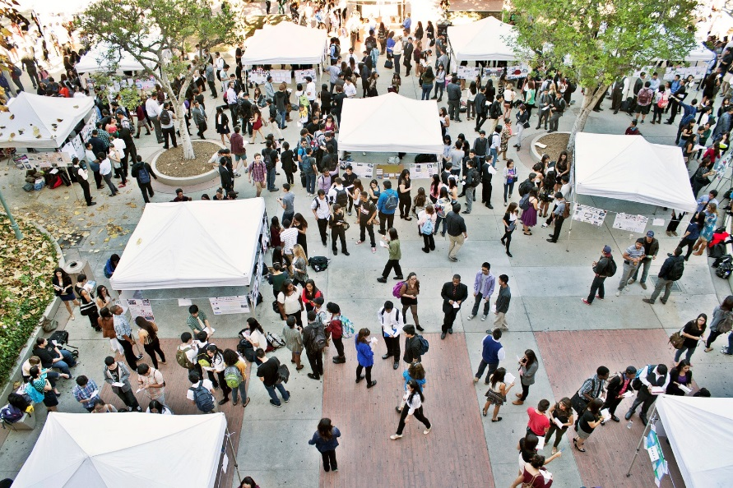
Notable College 1
Characteristics
Three-unit UC/CSU transferable course
Required professional learning for interdisciplinary faculty
Housed in counseling; can be taught by anyone with a Master’s
Information literacy, critical reading, college success skills, career exploration

Slide 21
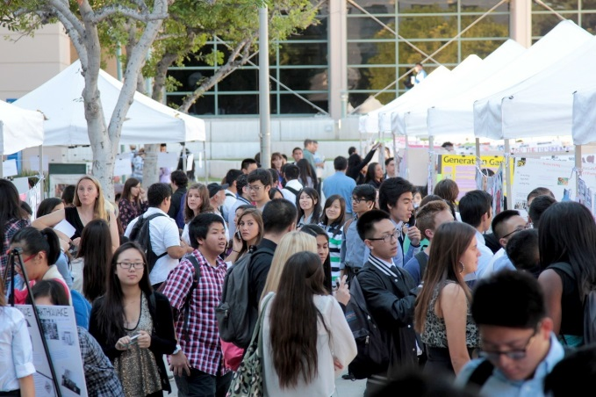
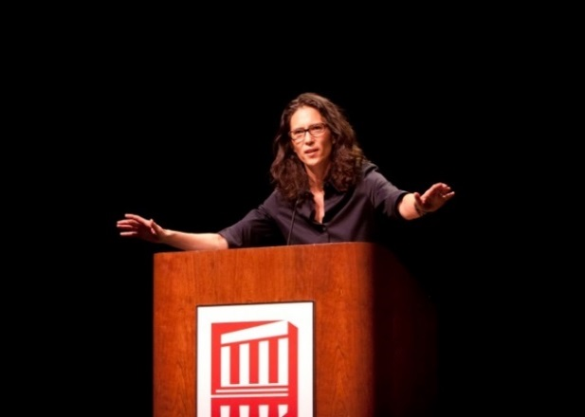
College 1
One Book, One College
Pathways Student Conference
https://youtu.be/hXpRjHunfNA

Slide 22
Pair / share
To what extent is your library currently involved in initiatives such as First Year Experience, Pathways, Equity, etc.?
What are your goals for your library’s involvement in this work?

Slide 23
pathways / library partnership
Elements of Our Partnership
Assessment
Challenges
Next Steps

Slide 24
Research skills among first-year students

Slide 25
elements of our partnership
Collaboration on Research Poster Assignment
Presentation at Summer Institute for College 1 Instructors
One Book, One College selection available to unlimited users as ebook
Online Information Literacy Assignments
Library Research Sessions
Poster Conference Assessment
Poster Showcase at the Library

Slide 26
information literacy assignments: created in Softchalk

Slide 27
Information literacy assignments: Proquest Research Companion videos

Slide 28
Library research sessions: College 1 Research Guide (LibGuide)

Slide 29
Poster showcase at the library

Slide 30
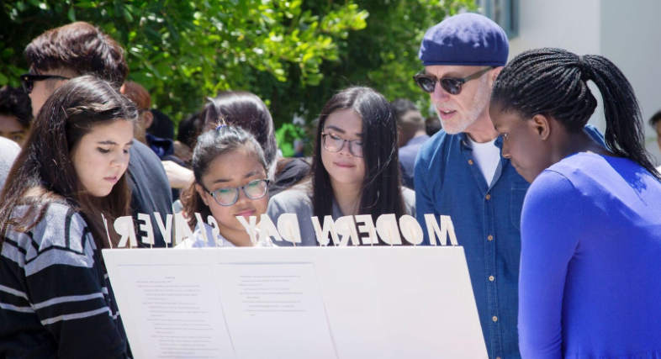
Assessment
Online Information Literacy Assignments – graded quizzes
Library Research Sessions – post-session student survey
Poster Conference – librarians’ assessment

Slide 31
Library research sessions: Post-session student survey Fall 2017

Slide 32
Library research sessions: student voices Fall 2017
“I didn’t realize we had so many resources available to us!”
“We were shown different ways to search so that we can find what’s relevant.”
“The databases are gonna help a lot for this project.”
“Can help me do research projects not just in College 1 but in all my classes.”

Slide 33
Poster conference: librarians’ assessment Fall 2017

Slide 34
Poster Conference: student voices Fall 2017
“I learned research involves trial and error.”
“Not all Internet sources are reliable. They can be false or exaggerated.”
“I learned how to simplify search results by using good keywords.”
“Databases make it easier to find specifically what’s needed.”
“I had to try more than one database to find the best source for my topic.”

Slide 35
Text set: Explore information literacy in college 1
Take a moment to scan the variety of texts
Select one or two that you would like to explore in depth
What questions or ideas does this text generate for you?

Slide 36
challenges
Scalability
Interdisciplinary Professional Learning
Prioritizing Information Literacy Outcomes
Assessment

Slide 37
Next steps
Poster Party!
“Presearch” Assignment
College 1 STEM Collaboration
College 1 Reader becoming an Open Educational Resource (OER)

Slide 38
Persistence – 2012-2013 Cohorts
UCLA, Social Research Methodology Group, 2015

Slide 39
Persistence by Race – 2012-2013 Cohorts
UCLA, Social Research Methodology Group, 2015

Slide 40
Transfer Status – 2012-2013 Cohorts
 | Transfer-Directed |  | Transfer-Prepared |  | Transfer-Ready |  | Total Students
 | Pathways | Non-Pathways | Pathways | Non- Pathways | Pathways | Non- Pathways | Pathways N | Non- Pathways N
Latino | 19% | 5% | 17% | 6% | 8% | 2% | 303 | 2,053
African American | 7% | 3% | 10% | 4% | 2% | 2% | 42 | 195
Overall | 31% | 13% | 28% | 13% | 19% | 9% | 620 | 4,035
UCLA, Social Research Methodology Group, 2015
Notes:
*Overall percentages include all students in Pathways and non-Pathways cohorts, not only those who identified as African American or Latino.

Slide 41
Questions? Comments?

