Slide 1
LSP Update
March 2018
Presented by:
Doug Achterman, CCL President; Head Librarian, Gavilan College
Amy Beadle, CCCTC Statewide Program Manager/Project Lead
Amy Carbonaro, CCCTC Statewide Program Manager

Slide 2
LSP Project Purpose and Plan
On behalf of the California Community college libraries, the California Community Colleges Chancellor’s Office (CCCCO), and the CCC Technology Center (CCCTC) are initiating a state-funded project to obtain a single cloud-based library services platform (LSP) to replace the various ILS systems now in use in any of the 114 libraries which choose to participate.

Slide 3
LSP Project Purpose and Plan
The CCCCO and the CCCTC will partner with the CCL to form project governance, develop a project workplan, select representative pilot colleges and complete the procurement process.
Once an LSP vendor is chosen and contracted; the project team, CCL and other stakeholders will work with the vendor to assure a successful implementation across the system.

Slide 4
LSP Project Leadership
CCL Task Force
CCCCO
CCCTC

Slide 5
LSP Project Leadership – CCL Task Force
Doug Achterman, CCL President;
Head Librarian, Gavilan College
Gregg Atkins, CCL Executive Director;
Alicia Virtue, CCL Treasurer;
Dean, Learning Resources & Educational Technology,
Santa Rosa Junior College

Slide 6
LSP Project Leadership – CCL Task Force
Leslie Tirapelle, CCL Regional Rep;
Dean of Library, Learning Resource and Distance Education,
Pasadena City College
John Taylor, CCL Regional Rep;
Dean, Library & Learning Support, Orange Coast College

Slide 7
LSP Project Leadership –- CCCCO
Gary Bird, Project Monitor
California Community Colleges Chancellor’s Office

Slide 8
LSP Project Leadership – CCCTC
Tim Calhoon, Executive Director
California Community Colleges Technology Center
Amy Beadle, LSP Statewide Program Manager
California Community Colleges Technology Center
Amy Carbonaro, Statewide Program Manager
California Community Colleges Technology Center

Slide 9
LSP Project Leadership – CCCTC Resources
Accessibility
Security
Data Management
Logistics
Project Management

Slide 10
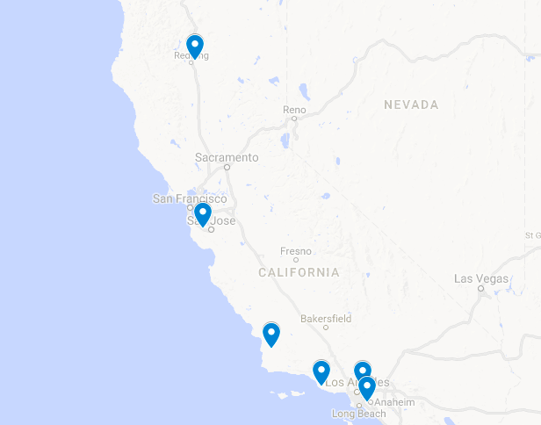
LSP Pilot Colleges
Shasta
Foothill
Allan Hancock
Pasadena
Oxnard
Cypress

Slide 11
Pilot College Selection Criteria
Location
FTEs
Population Density
Library Staffing
Current LSP Vendor
Single vs. Multi-College Districts

Slide 12
LSP Procurement & Selection Committee
Review and provide input on the Draft RFP
Score vendor proposals
Participant in and score vendor demonstrations
Provide a recommendation to BGCCD re: Intent to Award

Slide 13
LSP Procurement & Selection Committee
CCL Task Force
5
Pilot Colleges
12 (2 from each)
CCCTC Experts
4
CISOA
1-2
Student Senate
2-4
LSP Expertise
2-3

Slide 14
Input from the CCC system - Environmental Scan
How interested is your college in
participating in the LSP project?
10%
23% of Respondents are “Interested”
63% of Respondents are “Highly Interested”

Slide 15
Input from the CCC system - IdeaScale
Ideas were requested on five major categories directly related to RFP structure:
Discovery and User Interface
Resource Management, Cataloging & Acquisitions
Analytics
Circulation
Systems and Services

Slide 16
Input from the CCC system - IdeaScale
318 Comments
160 Unique Ideas
5382 Votes
73 Participating Colleges
272 Members

Slide 17
Input from the CCC system – FAQs
https://www.ccctechnology.info/ccctc/categories/ccctc_library_services_platform

Slide 18
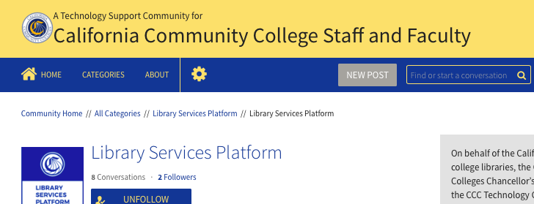
Input from the CCC system – FAQs

Slide 19
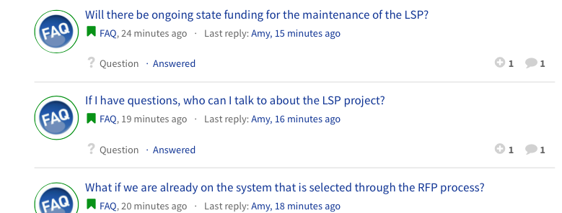
Input from the CCC system – FAQs

Slide 20
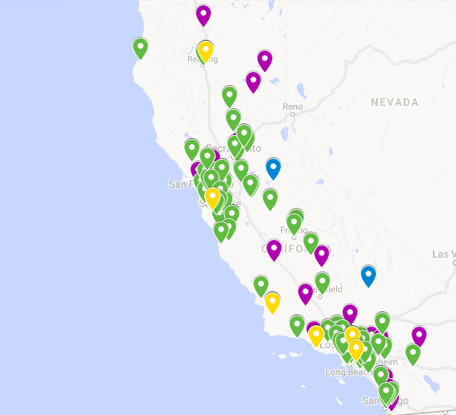
Input from the CCC system
Environmental Scan – 80 Pilot Colleges Selected – 6
IdeaScale – 73
Webinar Participation – 31
Active participation from 96 colleges
… 84% of the CCC libraries

Slide 21
LSP Project Timeline - 2017
January 2017
$6 Million LSP Project in Governor’s Budget
March 2017
CCL Task Force 1.0 Reviews Existing RFPs as models
June 2017
Budget signed, includes $6 million for LSP project
September 2017
LSP Task Force 2.0 formed, including CO, CCCTC and CCL
October-December 2017
LSP Task Force develops workplan
December 4, 2017
RFI released

Slide 22
LSP Project Timeline – January-February 2018
January 2018
Environmental Scan & Pilot College Applications Due
February 2018
Pilot Colleges selected
February 2018
IdeaScale campaign
February 2018
Pilot College Kick-off Meeting
February 2018
LSP Webinars
February 2018
RFP finalized with full committee

Slide 23
LSP Project Timeline – Procurement & Selection
March 2, 2018
RPF Released
March 30, 2018
RPF Responses Due
April 9-12, 2018
Vendor Demos
April 13, 2018
Intent to Award
May 2018
Recommendation to BGCCD Board
June 2018
Contract Signed

Slide 24
Issues to be pursued, once a vendor is chosen …
Ongoing Funding
Organizational Structure
Work Groups
Governance
Implementation Schedule

Slide 25
Benefits of a Systemwide, Cloud-based LSP
Enhanced Discovery
Integrated Workflow
Improved Maintenance
Unlimited Connectivity
Robust Analytics
State of the Art Architecture and Design
Collaboration with other CCC libraries

Slide 26
What Changes Might the New LSP System Bring?
Changed User Expectations
Changing Practices and Staff Use
Easier and More Productive Staff Use
Responsive Systems Able to Meet Unknown Demand
Broader, Deeper Reports and User Analysis
Interactive Connectivity to More Functionality
Integrate Library into Other Learning Environments
Intuitive
and Social

Slide 27
Q&A

Slide 28
Contacts:
Amy Beadle, Statewide Program Manager/Project Lead
abeadle@ccctechcenter.org
Doug Achterman, CCL President
dachterman@gavilan.edu
Thank you for your participation!

